Slide 1

SHARANYU APP
WE ARE SHARANYU
WE RISE BY LIFTING OTHERS…

Slide 2
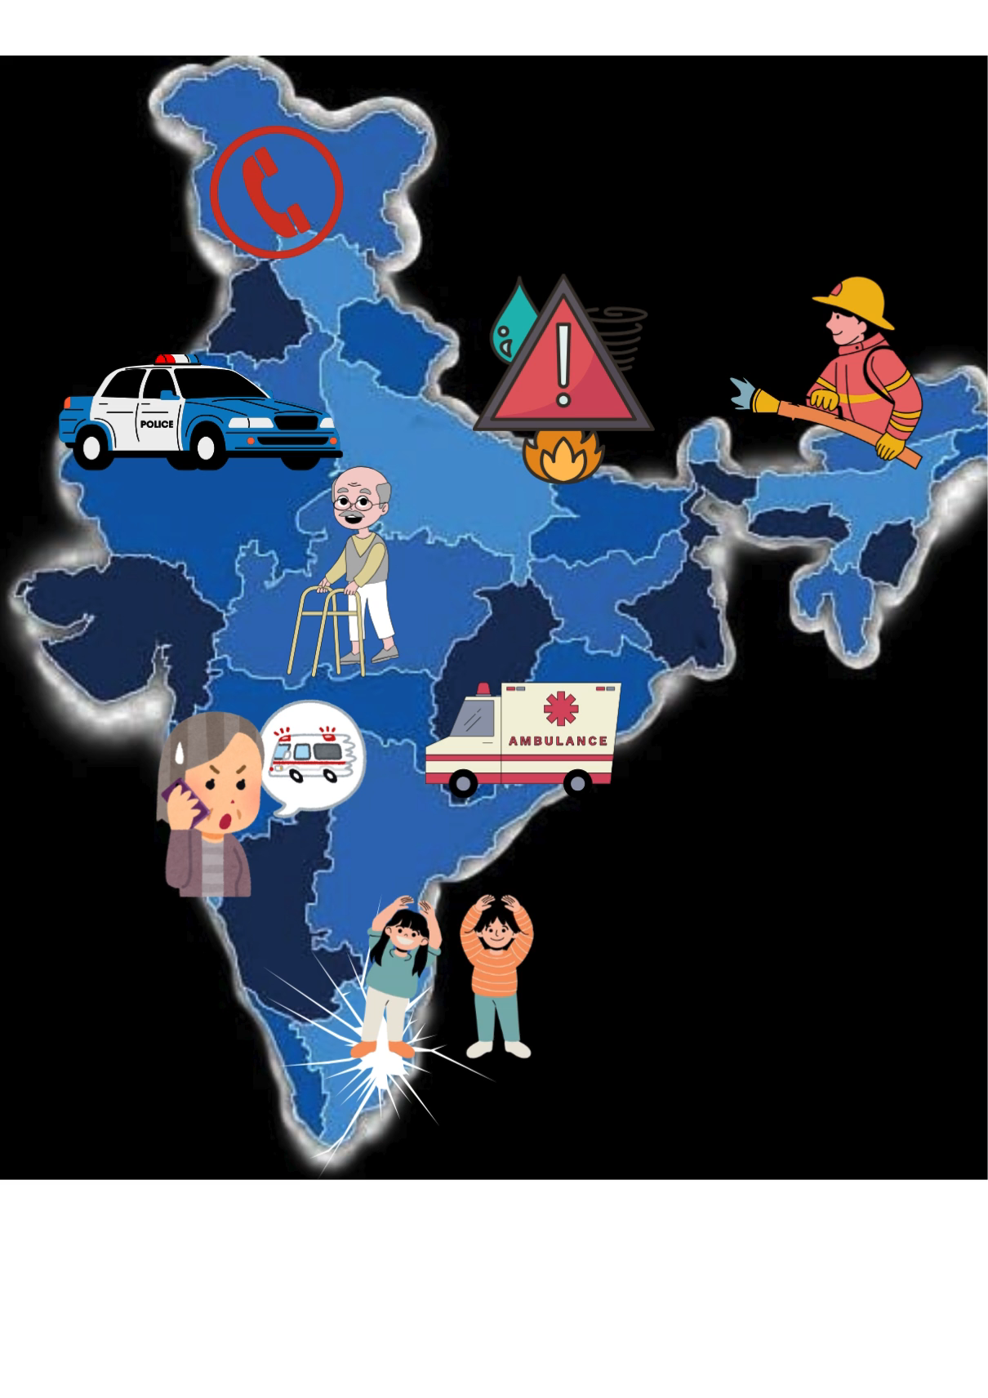
PROBLEM STATEMENT
This app stresses on following emergencies faced by citizens:
Crimes against women
Road Accidents
Theft /robbery
Fire Accidents
Disaster Management
Railways robbery, accidents and dacoities.
Airport robbery, accidents and dacoities.
Women and Child safety.
Murder, assault
Domestic Violence
Problems faced on highways and airports etc.
There are many cases in India when people are kept deprived from the emergency services or, their filed reports are not entertained by the authorities .
Sharanyu will make the process easy.

Slide 3
Solution
SHARANYU (the protector app)
SHARANYU app is based on:
Emergency Response Support System(ERSS)
to address different emergencies faced by the citizens instantly.
SHARANYU will allow you to file a report on the app and send emergency signals in the form of :
call audio recording
Video photo
SMS panic SOS SIGNAL

Slide 4








This app contacts following services :
Police
Ambulance
Fire safety
Women and Child helpline
Railways Authority
Disaster Management Authority
Airport Authority
NHAI

Slide 5


WORK FLOW DIAGRAM
Central server
State server
This process will take place within max 10 min
Citizens in Emergency
Local server
Services

Slide 6
WHY ONLY US?
User friendly interface : We provide the best user friendly interface which will help user even at the time of chaos.
User Security : We value user personal information and provides best user security . We will not even share the personal information with the local services to avoid any misuse.
Introducing snapchat feature: To avoid spamming of false information, videos, photos, etc.
We have introduced snapchat feature to the app that will allow true instant occurred cases only.
Camera With GPS: This app will send photos ,video, audio etc, along with time and location it was recorded
Call/Text facility also: This app will also allow user to call or text authorities directly insead of filing report.
Multi-Language Support system: This app will interact with the user in 22 major languages of India so,it can be user by all the age groups and communities.

Slide 7
SOS Button: A prominent feature that allows users to call for help with a single tap. This triggers an immediate alert to emergency services and designated contacts.
Certificate of Appreciation : All the citizens will be awarded with a certificate of appreciation to embark their contribution in making a better India by helping others.
No screen recording System

Slide 8
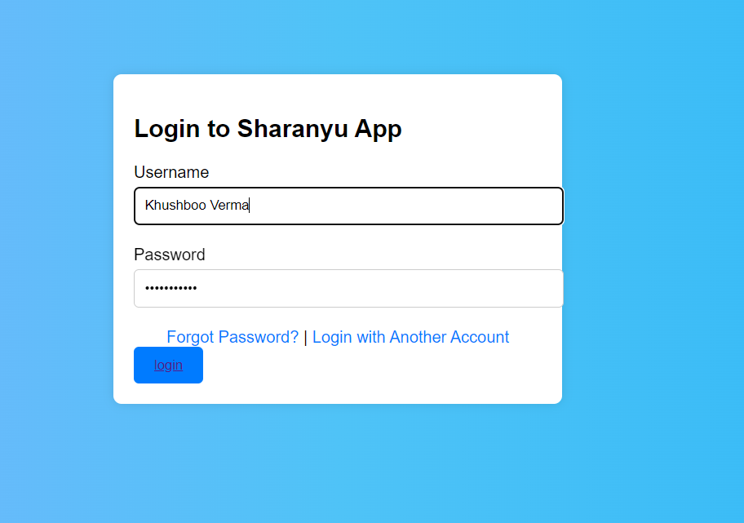
LOGIN INTERFACE OF SHARANYU
As you will open the app the first interface you will meet is the login interface.
Here you have to login with your Gmail id.

Slide 9
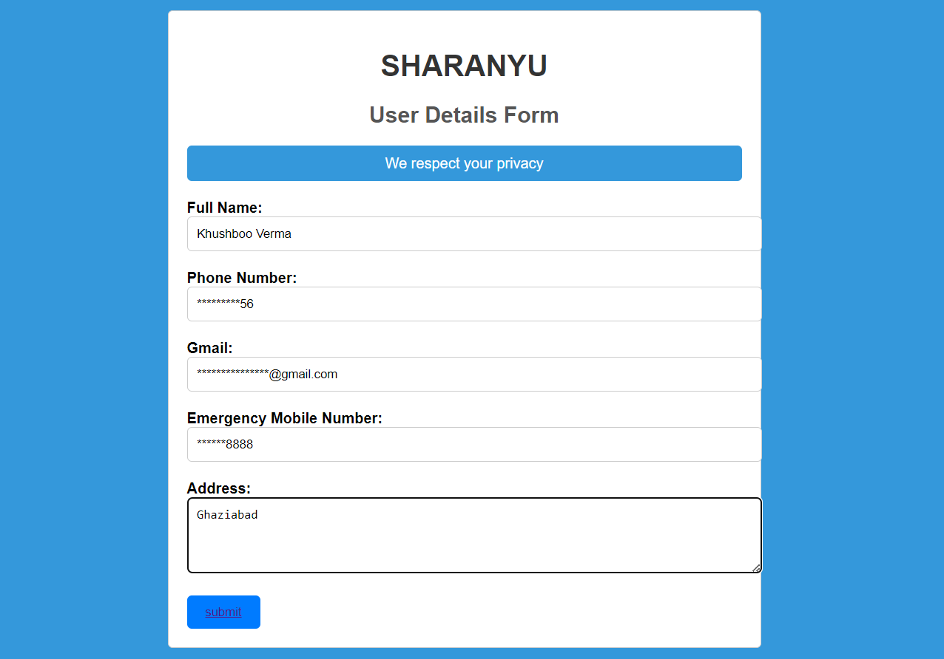
USER DETAILS FORM
This is the second interface
Here user have to enter his/her personal information which will be kept private by the app

Slide 10
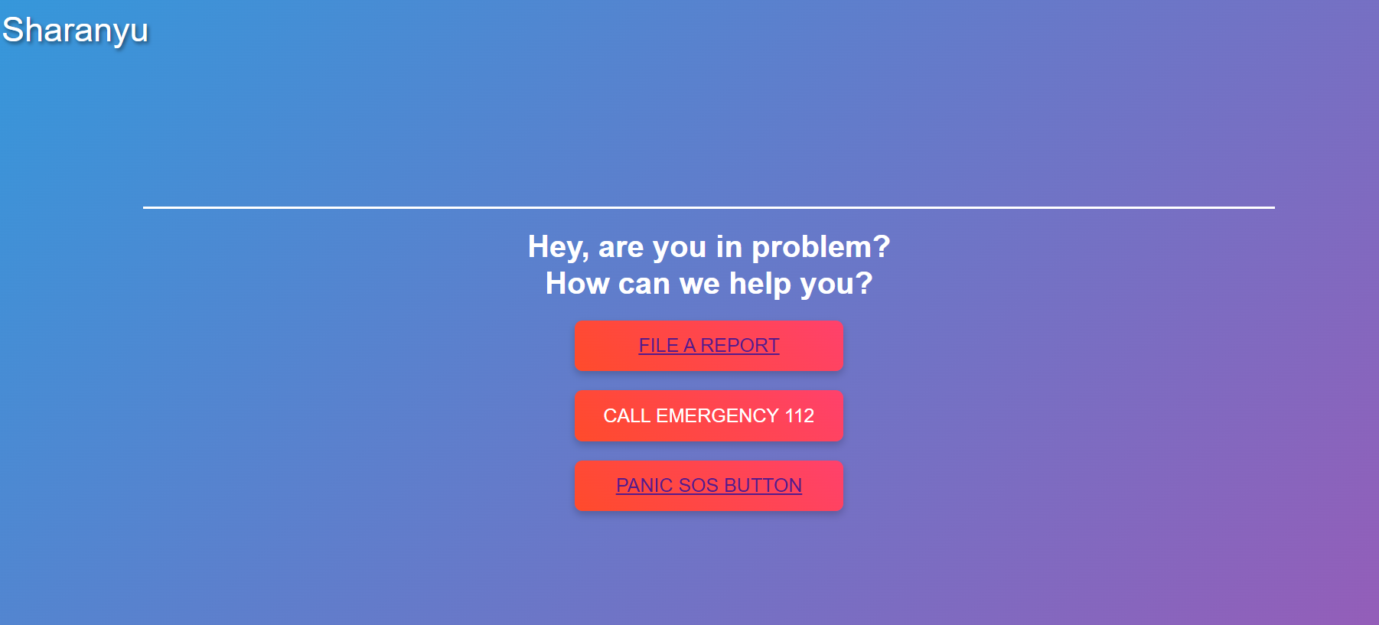
THIRD INTERFACE
This is the third interface the user will meet.
It will display three buttons :
File a report
Call emergency 112
Panic SOS button
Clicking on any of them will direct you to a new interface

Slide 11
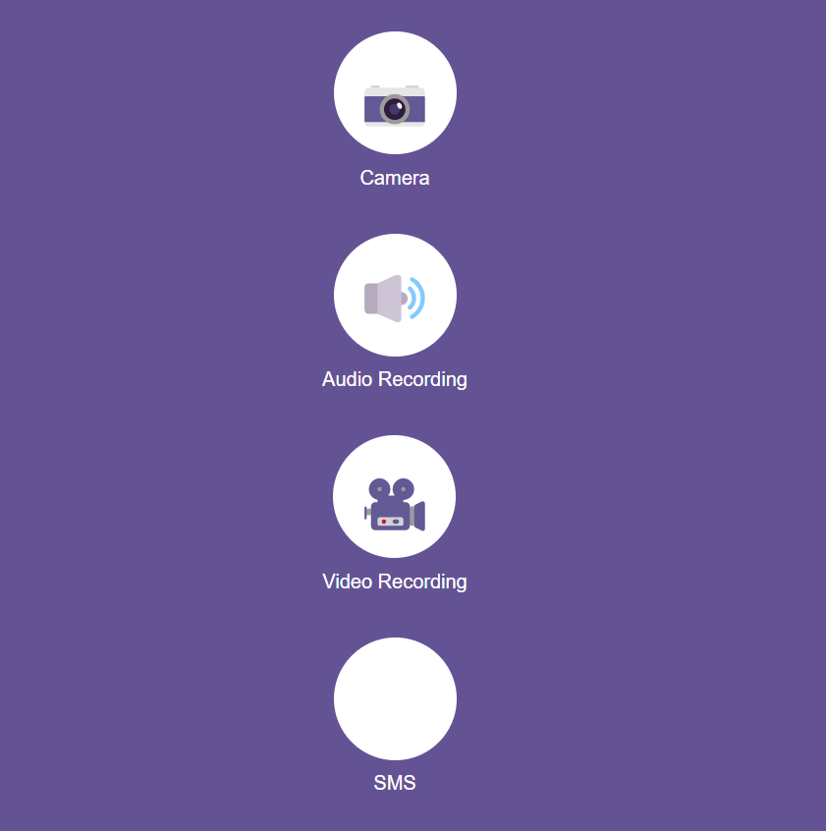
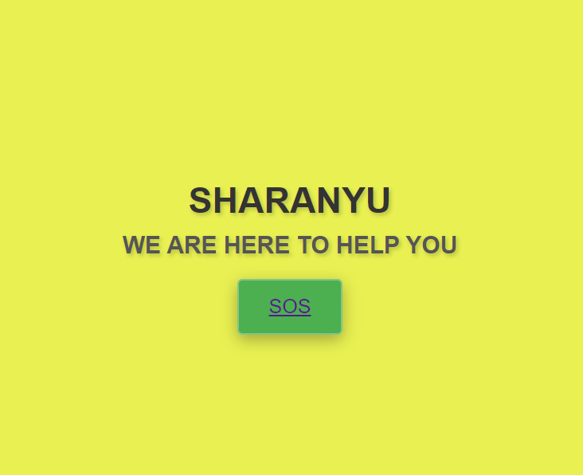
THIRD INTERFACE LEADS TO
When you will click on ‘file the report’.
You will be directed to this interface.
When you will click on ‘Emergency SOS button’.
You will be directed to this interface.

Slide 12
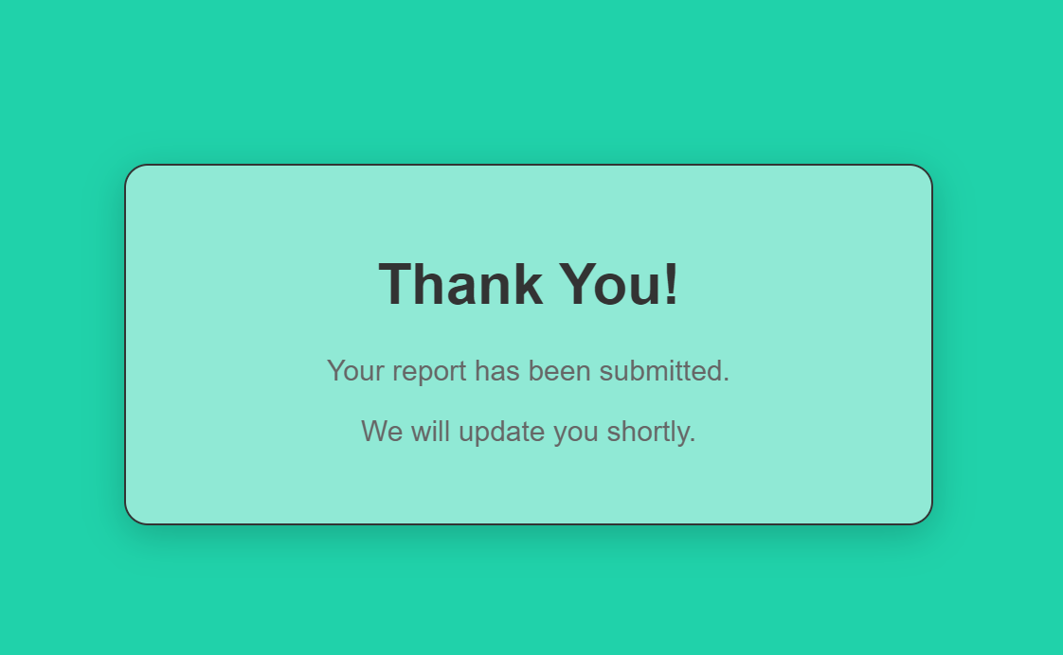
USER ASSURANCE INTERFACE
At last after submitting the response you will be directed to this page

Slide 13
Technology Stack
Front end Back end
(client side) (server side)
Python
Java
Node js
HTML
CSS
JAVA script
Database
SQL

